Slide 1
Hobby Project
Richard Redman

Slide 2
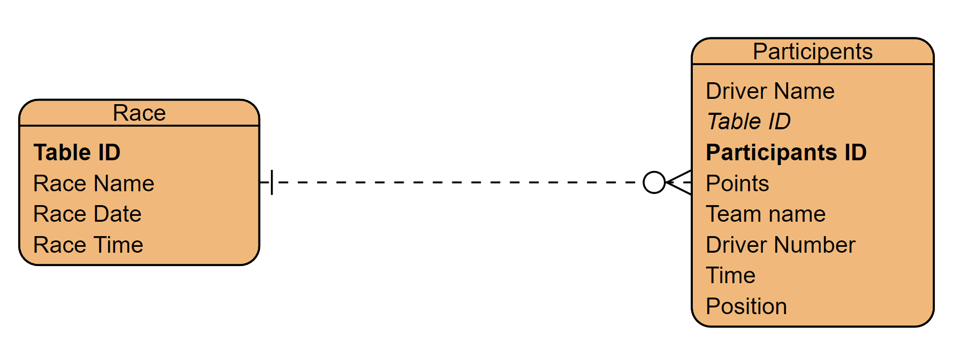
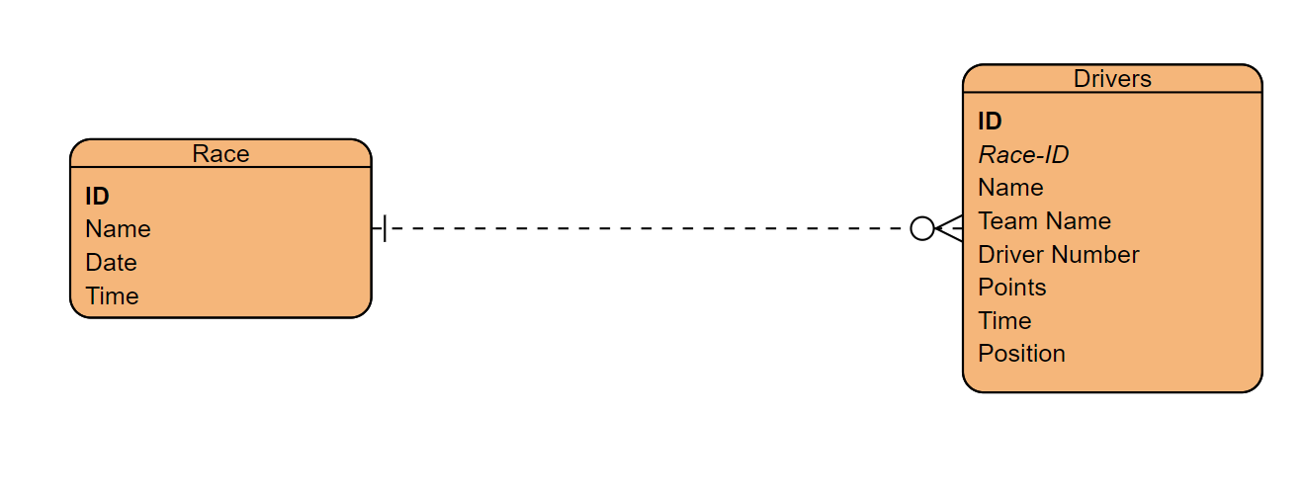
Approach
Web application
Backend Java
Database with a relation
Solution
Drivers and Races
Nested list
Crud Functionality
Modal and List Cards

Slide 3
Sprint Plan
Need Create a Nested list
Need Crud Functionality on Races
Need Crud Functionality on Drivers
Want Good looking frontend on all devices
Documentation(ERD, UML .etc)
Want user orderable lists
Want able to order by category
Need testing
Need compliable code

Slide 4







Technology learnt to the IMS
Git repos
Jira and Scrum boards
Java
SQL
Html/CSS
CSS
JavaScript
Junit/ Mockito
Selenium

Slide 5

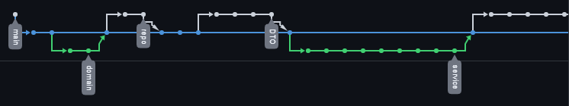
Version Control
GIT
Branch feature Model
Checkout new branch for each section
Merge back to dev
Push dev to Github repo

Slide 6
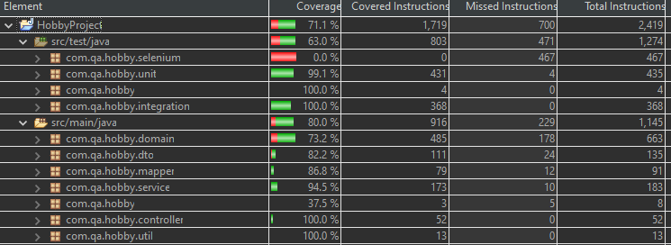
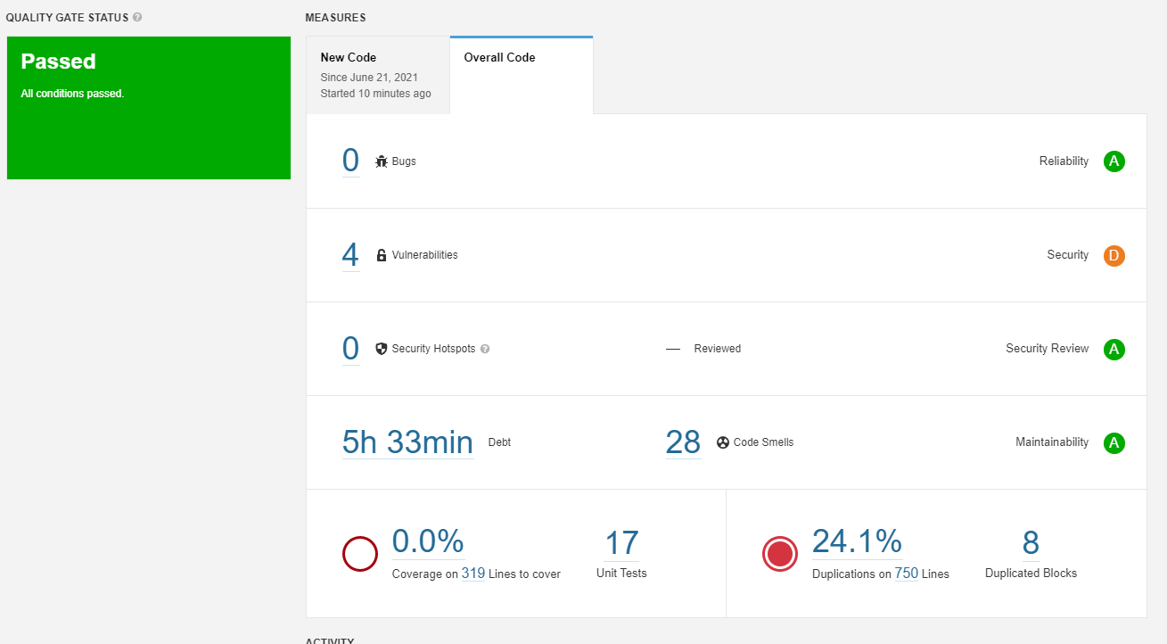
Testing
Good 80%test coverage
Very few code smells
A rating on ¾
No testing coverage seen
Some duplicate code
4 critical vulnerability's

Slide 7
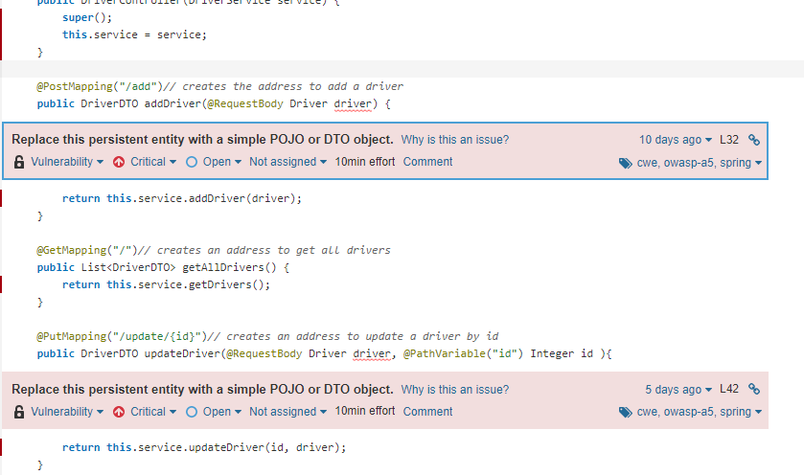
Vulnerability's
Within the Controllers
Incoming objects
Should used DTO for both sides
Malicious code sent to the DB

Slide 8
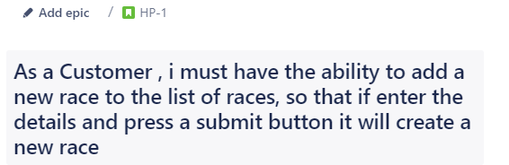
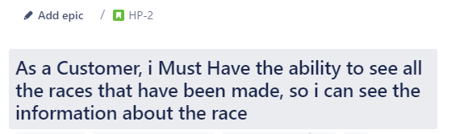
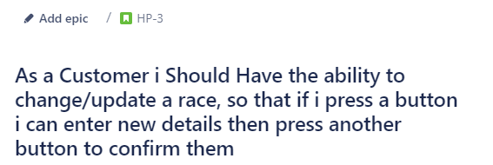
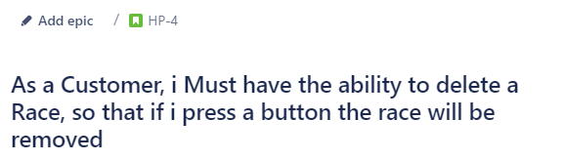
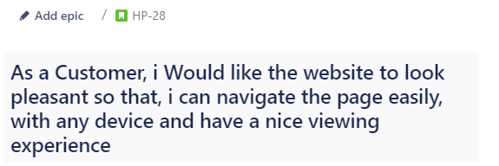
User stories

Slide 9
Demo of project

Slide 10

Sprint Review
Completed
Full Crud functionality
DB Storage
Working Front-end
Documentation
Testing
HTML and JavaScript
Left Behind
Ordered Lists
CSS use to make the page look better
DTO on the Receive side

Slide 11
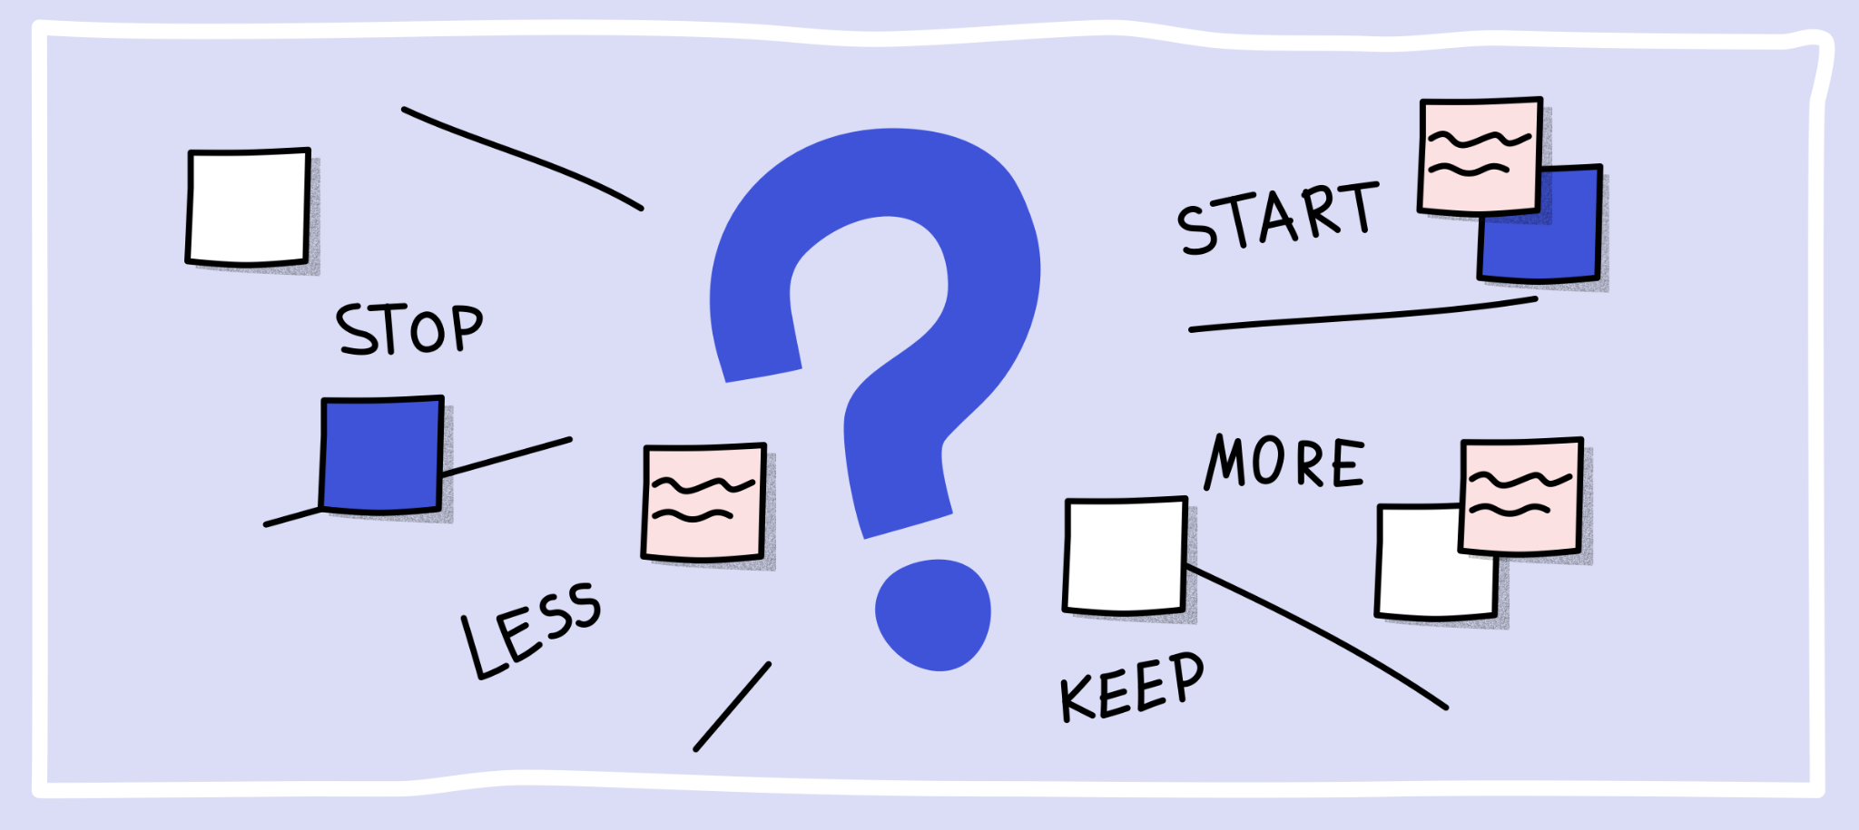
Sprint retrospective
Went well
Keep good structure JAVA
Keep Fully Working Project
Keep good testing coverage
Keep Front-end Structure
Keep Git and Jira
Keep initial Setup
Could be improved
More use of interfaces
More JavaScript Structure
More Security
More CSS
Stop using Thread. Sleep()
Start using Profiles

Slide 12

Lernt Outcomes
Focus more on JS
Java is Solid
Initial Setup
Look into Security of backend
Look into Bootstrap 5 objects
Plan for extra time to be left

Slide 13
Questions?

